Slide 1
PERSONALIZED CANCER DIAGNOSIS By-Pratiksha M

Slide 2
DATA COLLECTION
Data: (MSKCC)
Download training_variants.zip and training_text.zip from Kaggle.

Slide 3
PROBLEM STATEMENT
Classify the given genetic variations/mutations based on evidence from text-based clinical literature.

Slide 4
Real-world/Business objectives and constraints.
No low-latency requirement.
Interpretability is important.
Errors can be very costly.

Slide 5
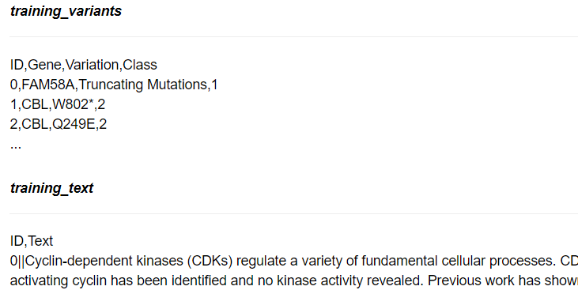
DATA OVERVIEW

Slide 6
Data Overview
We have two data files: one contains the information about the genetic mutations and the other contains the clinical evidence (text) that human experts/pathologists use to classify the genetic mutations.
Both these data files are have a common column called ID.
Data file's information:
training_variants (ID , Gene, Variations, Class)
training_text (ID, Text)

Slide 7
Type of Machine Learning Problem
There are nine different classes a genetic mutation can be classified into => Multi class classification problem

Slide 8
Train, CV and Test Datasets
Split the dataset randomly into three parts train, cross validation and test with 64%,16%, 20% of data respectively

Slide 9
Preprocessing of text
loading stop words from nltk library.
replace every special char with space.
replace multiple spaces with single space.
If the word is a not a stop word then retain that word from the data.
merging both gene_variations and text data based on ID.

Slide 10
Splitting data into train, test and cross validation (64:20:16)
We split the data into train, test and cross validation data sets, preserving the ratio of class distribution in the original data set.
Number of data points in train data:2124
Number of data points in test data:665
Number of data points in cross validation data:532

Slide 11
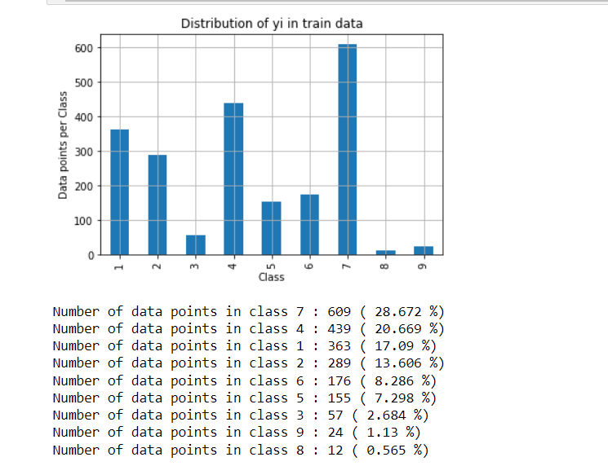
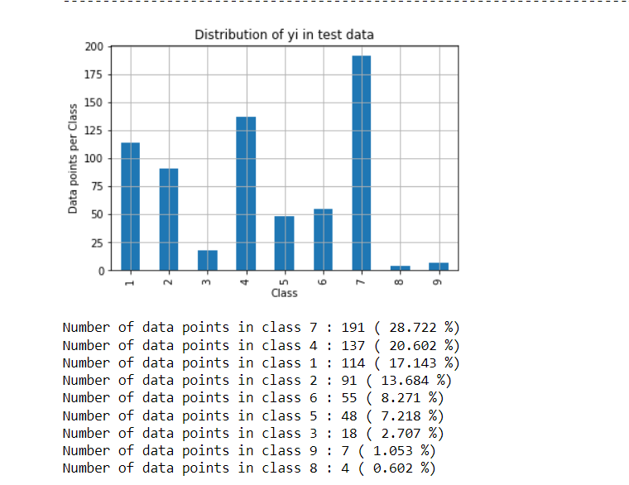
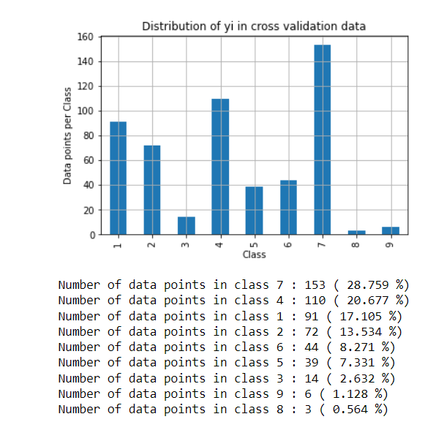
Distribution of yi in train,test and CV data

Slide 12
Prediction using a 'Random' Model.
In a 'Random' Model, we generate the NINE class probabilites randomly such that they sum to 1.

Slide 13
Univariate Analysis on Gene Feature.
Q1. Gene, What type of feature it is ?
Ans. Gene is a categorical variable.
Q2. How many categories are there and How they are distributed?
Ans. There are 234 different categories of genes in the train data.
For this problem of multi-class classification with categorical features, one-hot encoding is better for Logistic regression while response coding is better for Random Forests.

Slide 14
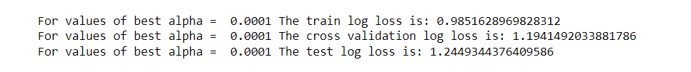
How good is this gene feature in predicting y_i?
Is the, the CV and Test errors would be significantly more than train error. Gene feature stable across all the data sets (Test, Train, Cross validation)?
Ans. Yes, it is. Otherwise

Slide 15
Naive Bayes
Naive Bayes classifier for multinomial models.
The multinomial Naive Bayes classifier is suitable for classification with discrete features (e.g., word counts for text classification). The multinomial distribution normally requires integer feature counts.

Slide 16
K Nearest Neighbour Classification Neighbors-based classification is a type of instance-based learning or non-generalizing learning: it does not attempt to construct a general internal model, but simply stores instances of the training data. Classification is computed from a simple majority vote of the nearest neighbors of each point: a query point is assigned the data class which has the most representatives within the nearest neighbors of the point.

Slide 17
Logistic Regression Stochastic Gradient Descent (SGD) is a simple yet very efficient approach to fitting linear classifiers and regressors under convex loss functions such as (linear) Support Vector Machines and Logistic Regression.

Slide 18
Linear Support Vector Machines Support vector machines (SVMs) are a set of supervised learning methods used for classification, regression and outliers detection.

Slide 19
Thank you!

